Slide 1


Comparison of Imaged-Based Gender Classification Techniques
Dataset: IMDB face images
Team Members:
Savith Jayasekera
Oscar Chen
Prince Okoli
ENSF 619
BigData-Winter 2019
Notes:
This presentation in mandatory for all of the team, No presentation = 0% (Project)
The presentation length should be EXACTLY 150 seconds (2.5 minutes)
Please do not change the fonts!
Presentation time: April 1st , from 2:00 to 3:15pm, BI 587

Slide 2
Motivation
Use Spark to analyze the data
Build an accurate image classifier
Compare the performance of:
Convolutional Neural Networks
Support Vector Machine
Logistic Regression K-Nearest Neighbor
Linear Discriminant analysis
Gaussian Naïve Bayes
Random Forest
ENSF 619.25
Machine Learning-Winter 2019

Slide 3
Preprocessing
Parse Matlab database
Cleaning data in Spark
Produce smaller datasets for early trials
Turn into
ENSF 619.25
Machine Learning-Winter 2019

Slide 4
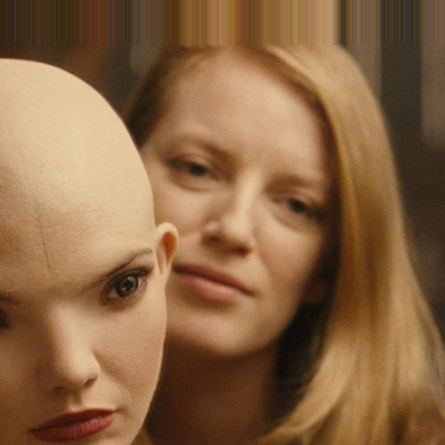
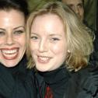
Cleaning with PySpark
Started out with 452,261 images.
Removed images with more than one face using pyspark sql. Result: 181,626.
ENSF 619.25
Machine Learning-Winter 2019

Slide 5
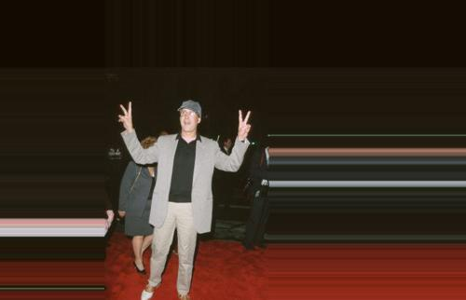
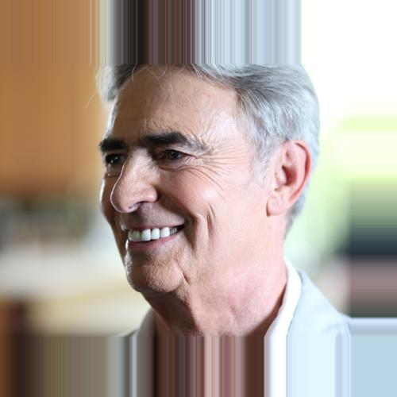
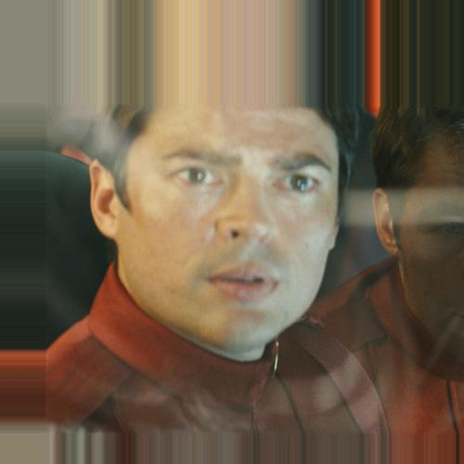
Cleaning with PySpark
Removed images with a stretched-out using pyspark sql. Result: 163,336 images.
ENSF 619.25
Machine Learning-Winter 2019

Slide 6
Cleaning with PySpark
Entire dataset (100%)
Nodes | Tasks | Duration (seconds)
1 | 5 | 0.67
5 | 5 | 0.59
5 | 1 | 0.65
3 | 3 | 0.62
1 | 1 | 0.61
10% of dataset
Nodes | Tasks | Duration (seconds)
1 | 5 | 0.63
5 | 5 | 0.59
ENSF 619.25
Machine Learning-Winter 2019

Slide 7
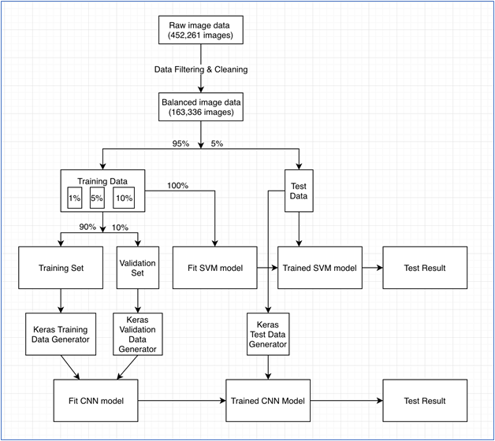
Overall Data Processes
ENSF 619.25
Machine Learning-Winter 2019

Slide 8
Learning experiment
Classifiers:
Linear Discriminant Analysis
Multinomial Logistic regression
Gaussian Naïve Bayes classifier
K-Nearest Neighbor
Support Vector Machine
ENSF 619.25
Machine Learning-Winter 2019

Slide 9
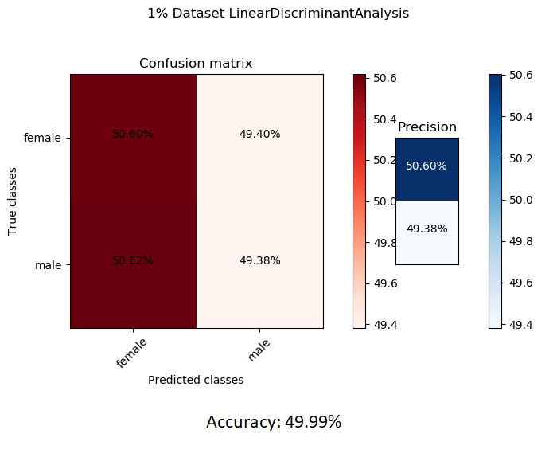
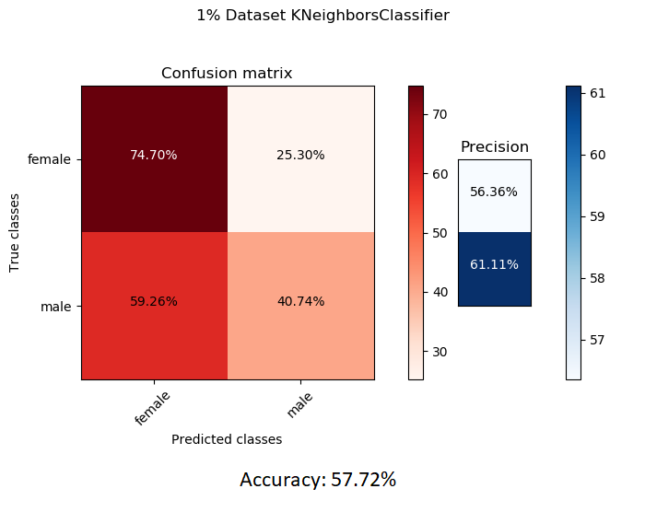
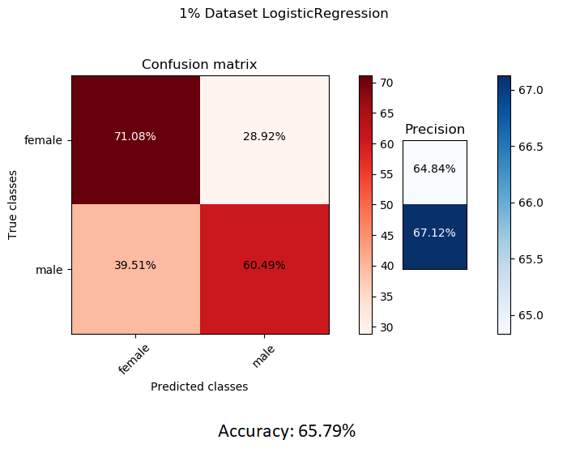
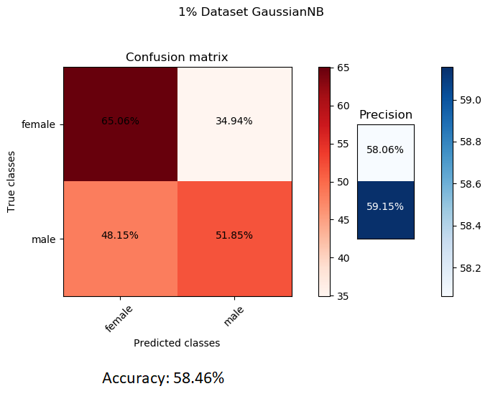
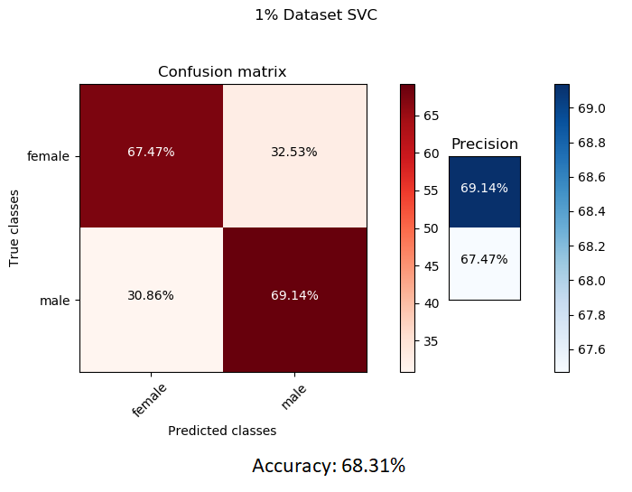
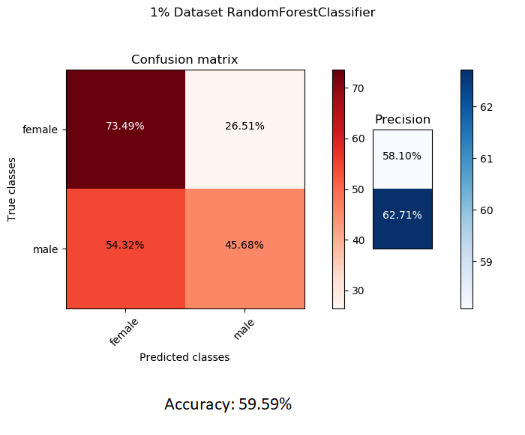
Learning experiment: 1% data
ENSF 619.25
Machine Learning-Winter 2019

Slide 10

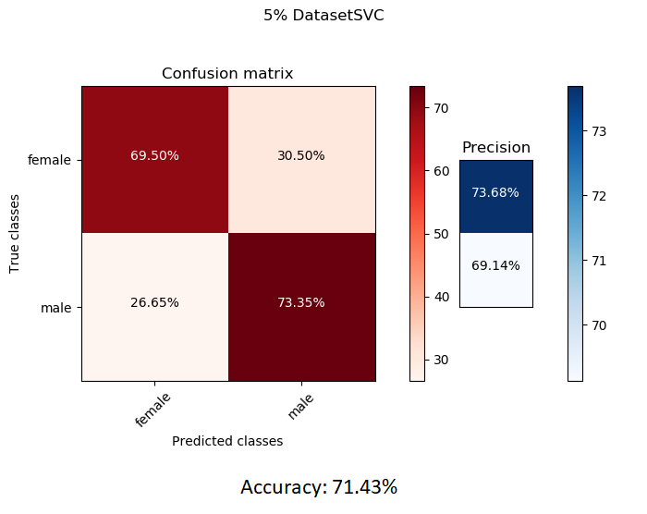
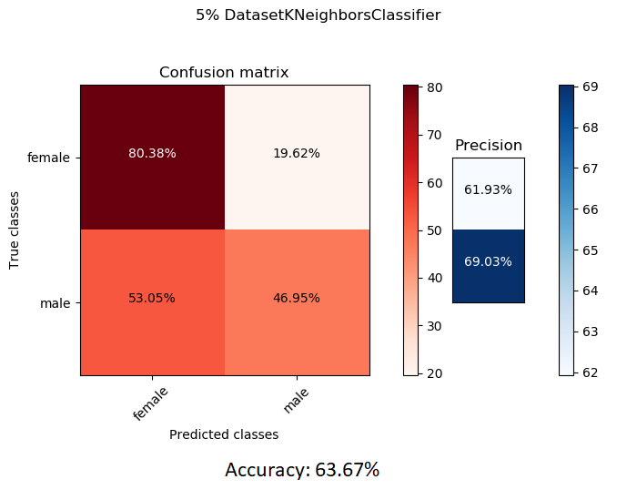
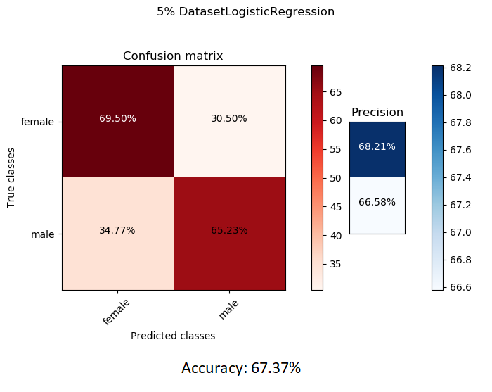
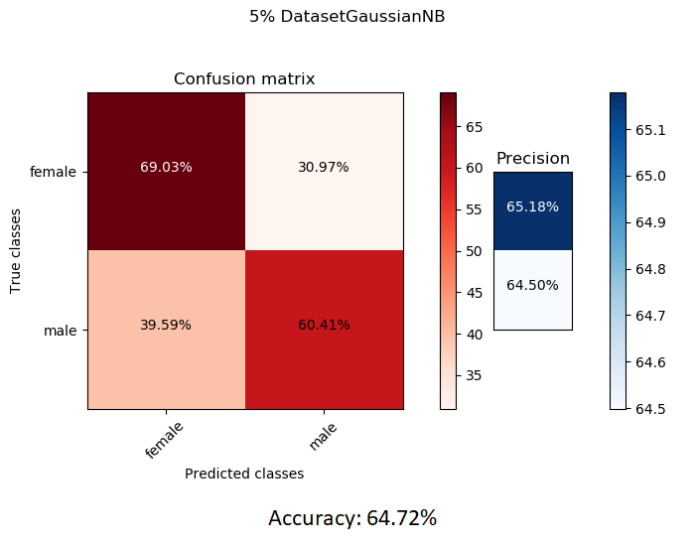
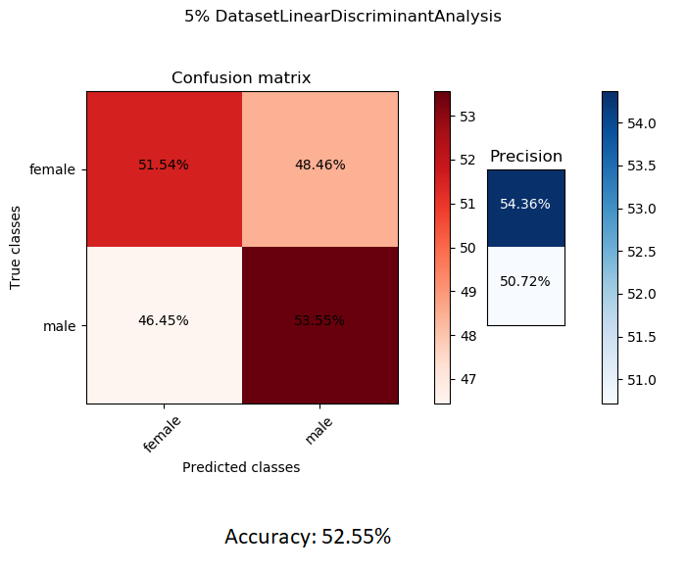
Learning experiment: 5% data
ENSF 619.25
Machine Learning-Winter 2019

Slide 11
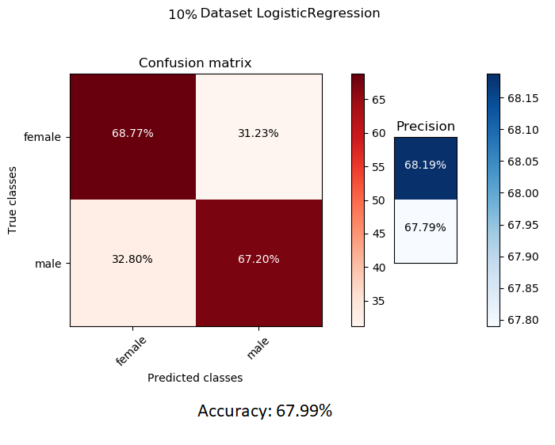
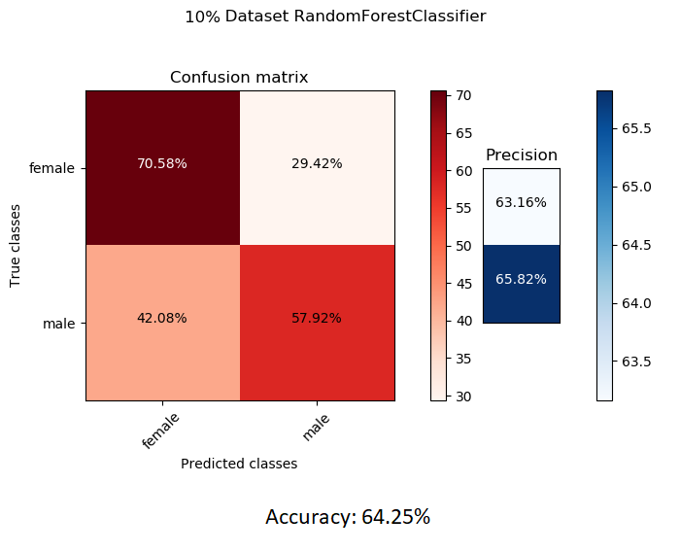
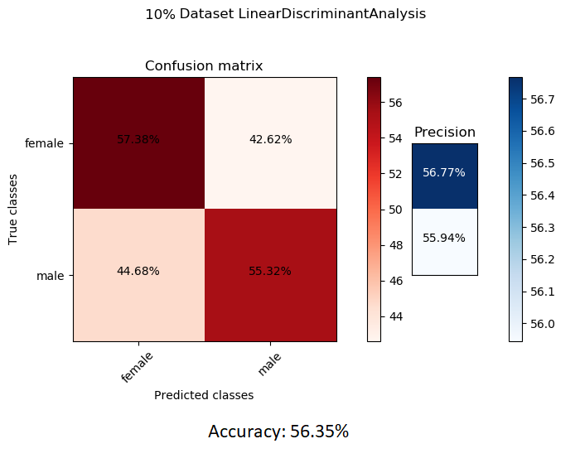
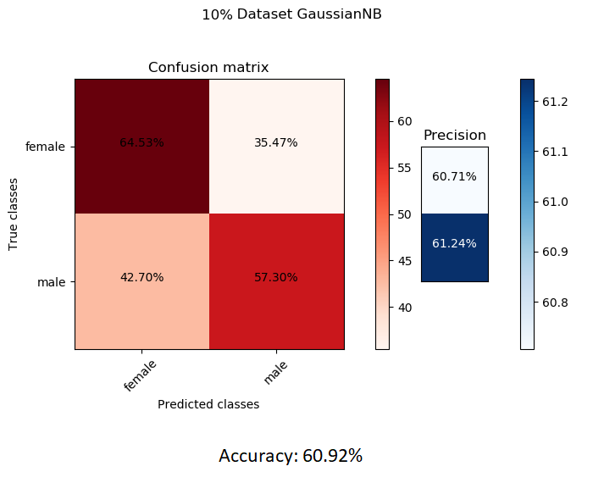

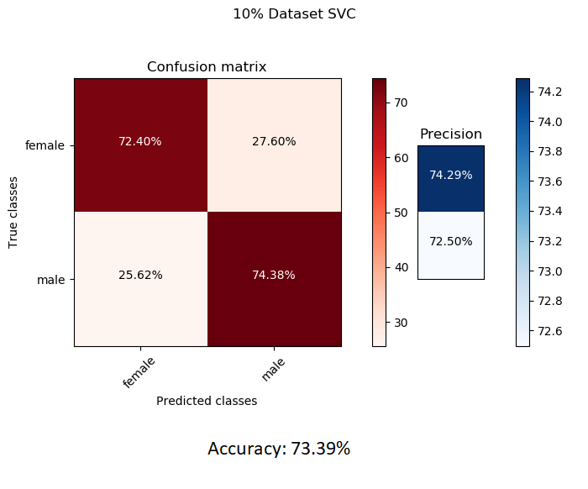
Learning experiment: 10% data
ENSF 619.25
Machine Learning-Winter 2019

Slide 12
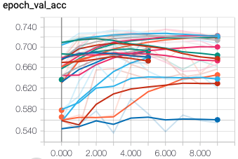
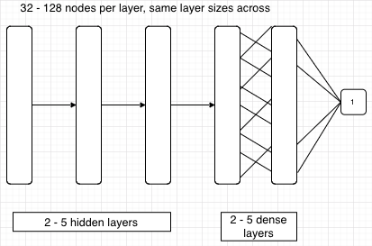
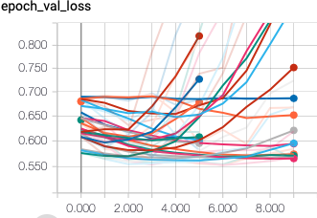
Learning experiment
Deep learning – Simple CNN on 1-5% data sets
ENSF 619.25
Machine Learning-Winter 2019

Slide 13
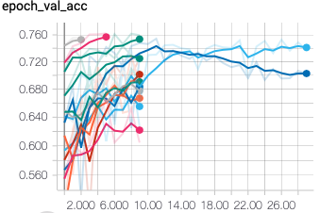
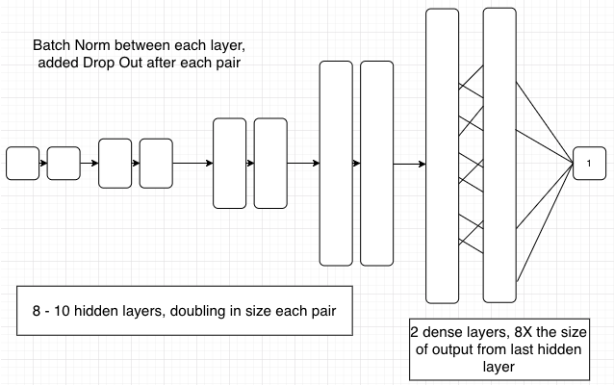
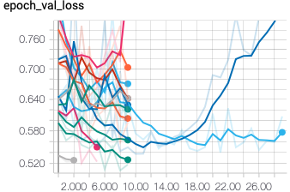
Learning experiment
Deep learning: More complex CNNs on 10% datasets
ENSF 619.25
Machine Learning-Winter 2019

Slide 14
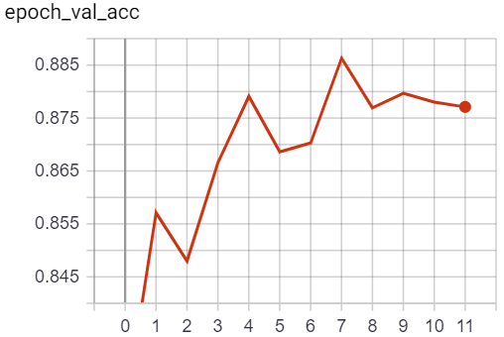
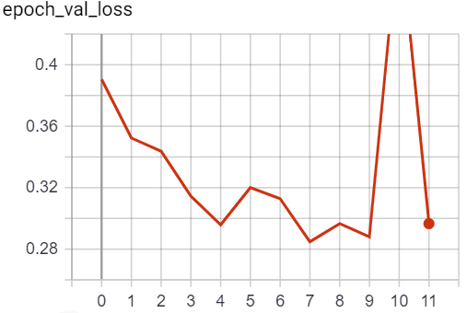
Final Model Training
ENSF 619.25
Machine Learning-Winter 2019

Slide 15
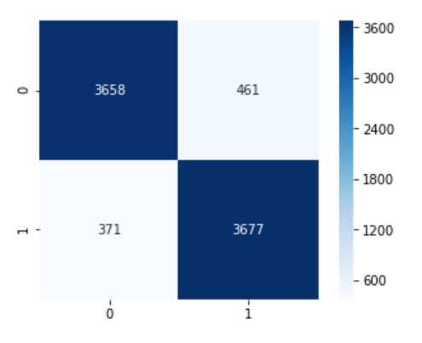
Learning experiment: SVM vs. CNN
SVM
CNN
Specificity: 89%
Recall: 91%
Precision (Male): 89%
Precision (Female): 91%
Accuracy: 90%
ENSF 619.25
Machine Learning-Winter 2019

Slide 16
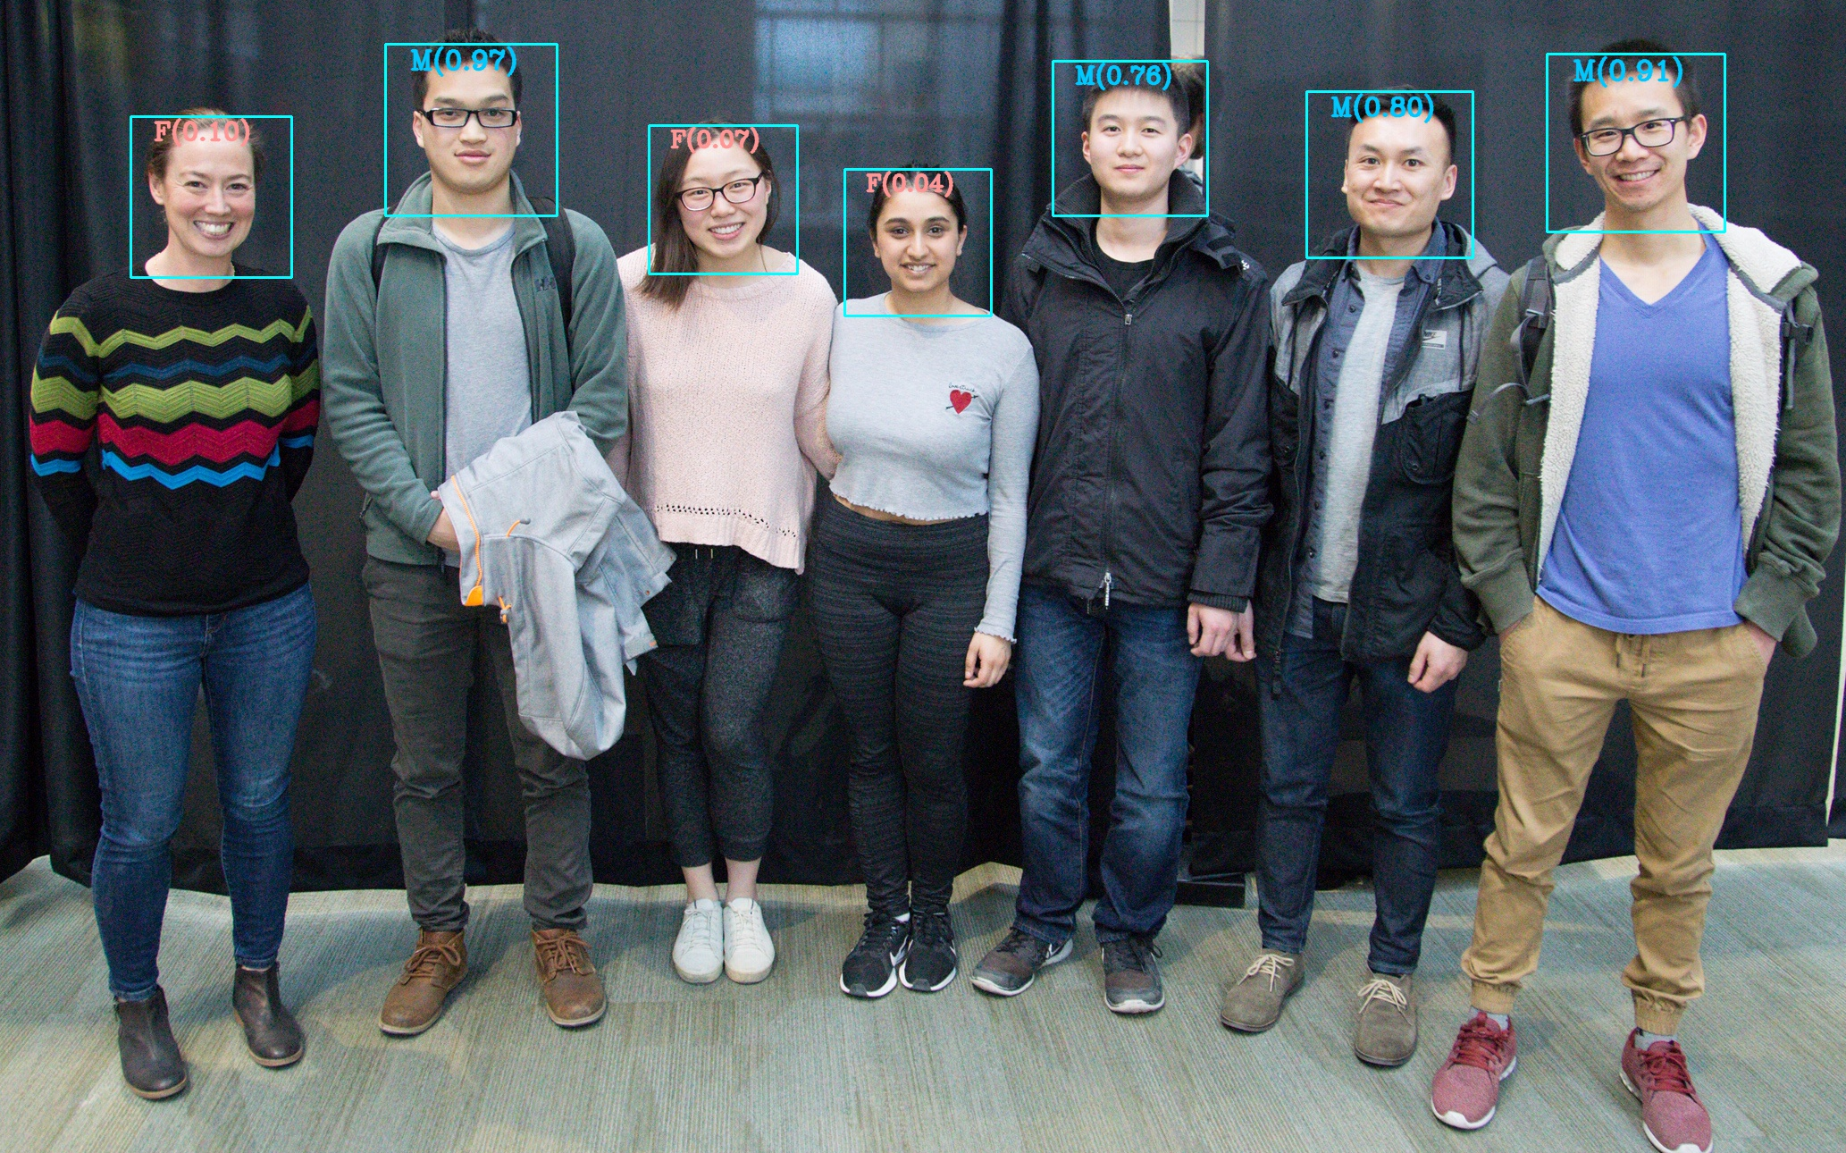
Demo
ENSF 619.25
Machine Learning-Winter 2019

Slide 17
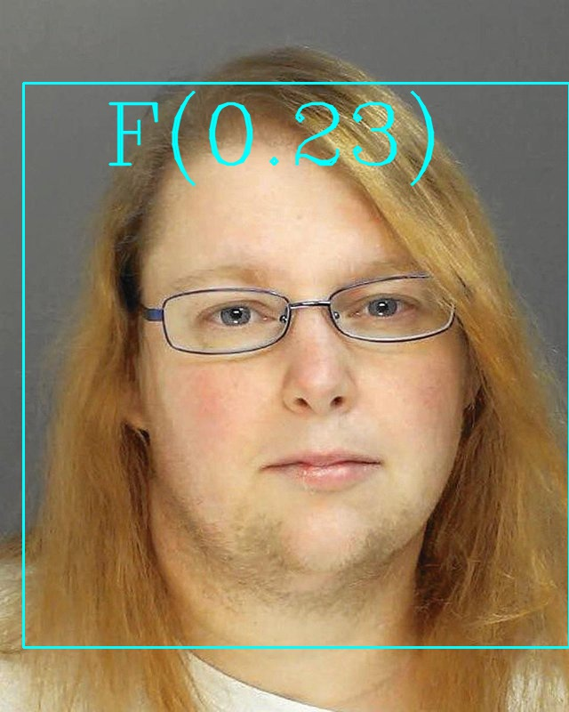

Are You Smarter Than A Computer?
Female
https://www.reddit.com/r/SwordOrSheath/comments/b3fsay/sosh_this_felon/?utm_source=share&utm_medium=web2x
ENSF 619.25
Machine Learning-Winter 2019

Slide 18
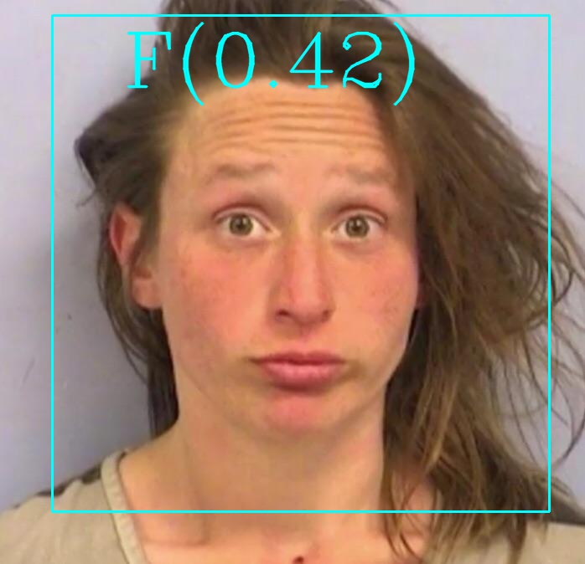
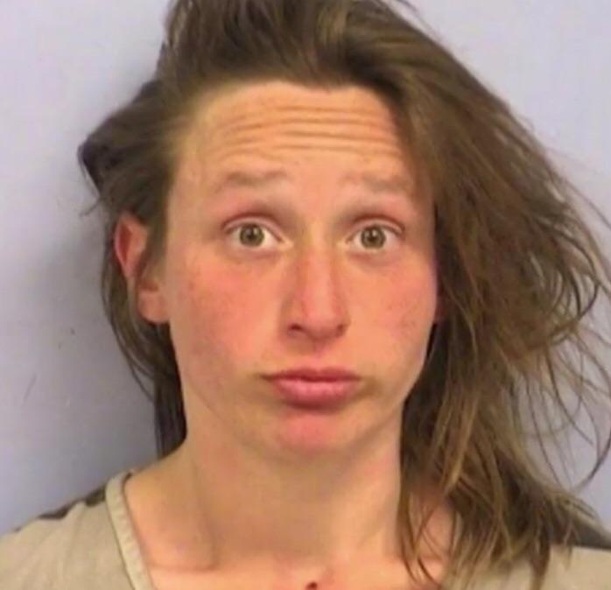
Are You Smarter Than A Computer?
Female
https://www.reddit.com/r/SwordOrSheath/comments/am7y7p/sosh_arrested_for_public_masturbation/?utm_source=share&utm_medium=web2x
ENSF 619.25
Machine Learning-Winter 2019

Slide 19
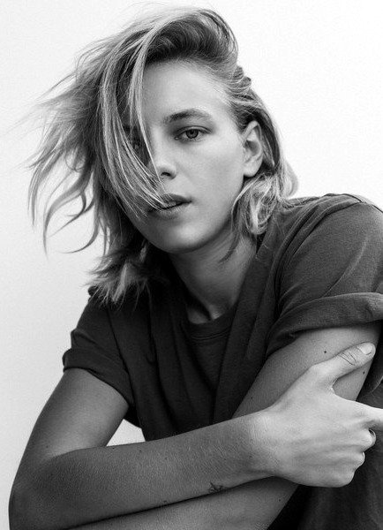
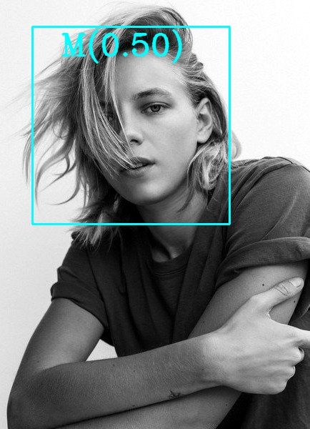
Are You Smarter Than A Computer?
Female
https://www.reddit.com/r/SwordOrSheath/comments/agmtl9/sosh_this_model/?utm_source=share&utm_medium=web2x
ENSF 619.25
Machine Learning-Winter 2019

Slide 20
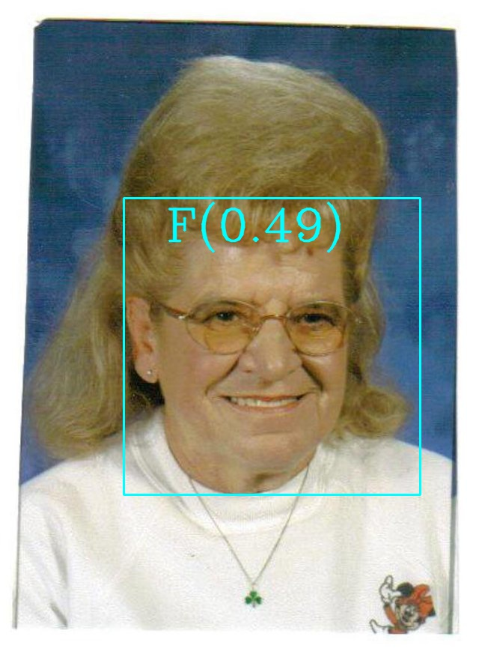
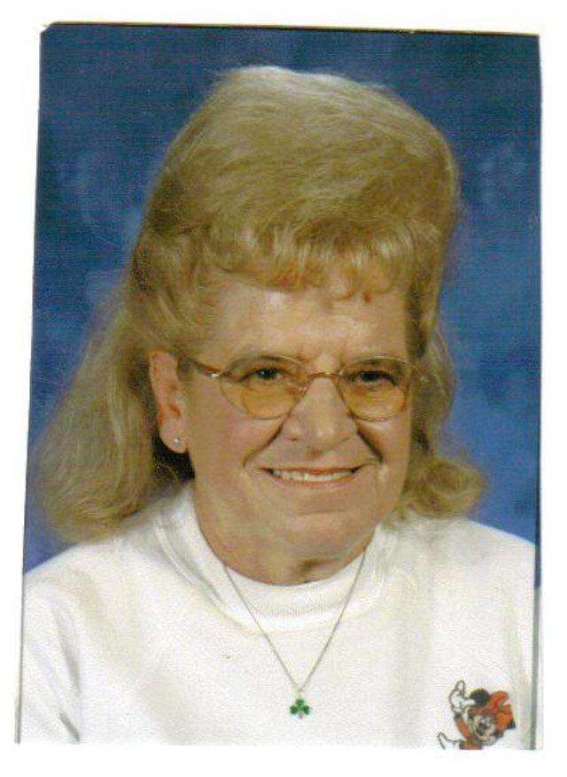
Are You Smarter Than A Computer?
Male
https://www.reddit.com/r/SwordOrSheath/comments/afqkvm/sosh_this_individual/?utm_source=share&utm_medium=web2x
ENSF 619.25
Machine Learning-Winter 2019

Slide 21
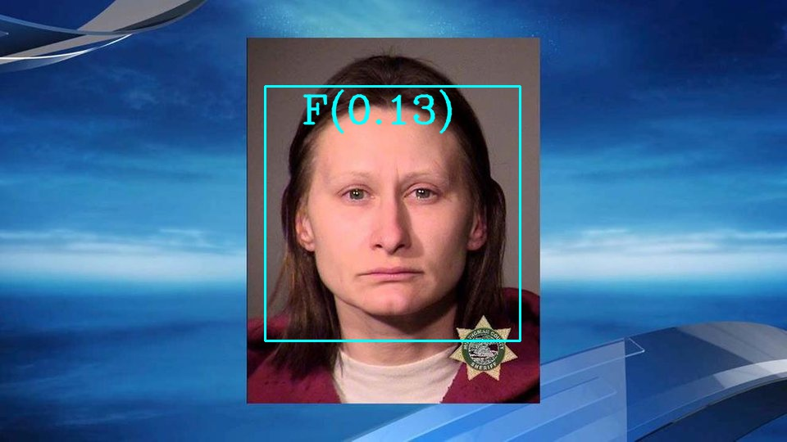
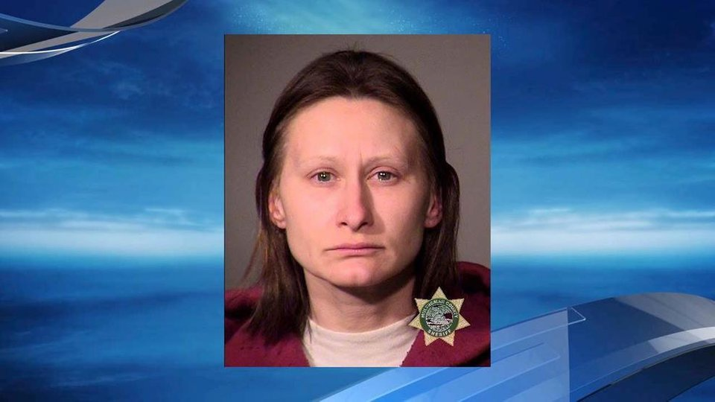
Are You Smarter Than A Computer?
Female
https://www.reddit.com/r/SwordOrSheath/comments/av9roj/sosh_this_convicted_felon_who_attempted_to_bring/?utm_source=share&utm_medium=web2x
ENSF 619.25
Machine Learning-Winter 2019

